Slide 1
The role of the microbiome in asthma
Developed in collaboration with Dr Sarah Diver and Associate Professor Asger Sverrild

Slide 2
Contents
Key principles
Microbiome
Healthy versus asthmatic airways
The influence of the microbiome on the pathophysiology of asthma
Influence on disease severity
Microbiome composition
Microbiome composition
Homeostasis vs dysbiosis
Epithelial function
Immune response
Exacerbations
Nutrient availability
Environmental and therapeutic effects
Summary of host-microbiome interactions
Introduction to the airway microbiome
Evolution of the understanding of the airway microbiome
The taxa of the airway microbiome
Sputum microbiome as a marker
Key areas of future airway microbiome research
Homeostasis
Sequencing methods
Microbial diversity
Phylogenetic tree

Slide 3
Key definitions
3

Slide 4






Key principles: Microbiome
Microbiota
A community of microorganisms (such as bacteria, fungi, viruses, archaea, protists and algae) that inhabit a particular environment and especially those living in or on the human body^{1,2}
Airway microbiome
A multi‐kingdom microbial ecosystem that inhabits the respiratory system:
Microbiota and their structural elements and surrounding environmental conditions^{1,3}
Bacteriome or bacterial microbiome⁴
Composed of bacteria
Mycobiome⁴
Composed of funghi
Virome⁴
Composed of viruses
Commensal bacteria
Commensal bacteria are the microorganisms that reside on and within the human body without causing harm under normal conditions⁵
Bacteriophage
Viruses that infect bacteria; shape bacterial populations and airway homeostasis⁶

Slide 5




Key principles: Homeostasis
Homeostasis
A balanced, stable host–microbiome state that supports normal function¹
Dysbiosisª
Disrupted microbial community is associated with disease or inflammation²
Host-microbiome interactions
Complex relationships between microorganisms and their host, ranging from symbiotic and mutualistic to pathogenic and parasitic dynamics^{2,3}

Slide 6
Key principles: Sequencing methods
Amplicon sequencing of the 16S rRNA of the microbiome¹
The 16S rRNA gene is found in all bacteria and archaea parts of the gene are highly conserved therefore it can be used to identify micro-organisms present in a sample
Nine hypervariable regions (V1–V9) within the 16S rRNA gene can be amplified and sequenced
Positives/Negatives:
Widely standardised protocols and bioinformatics pipelines allow robust identification of most common bacterial genera
Lower resolution compared with WGS sequencing
Whole gene sequencing^{1,2}
Depends on fragmentation and random sequencing of the totally extracted microbiome DNA
Positives/Negatives:
Possible to identify organisms to species or even strain level
Provides the opportunity to assess the functional characteristics of bacteria such as virulence or antimicrobial resistance
More expensive and requires higher computational power than amplicon sequencing
Less suited to low biomass samples such as sputum, often high contamination by host DNA

Slide 7


Key principles: Microbial diversity
Diversity: The richness (total number of operational taxonomic unit (OTU)) and evenness (relative abundance of the OTU) in a defined area¹
This sample has greater richness and evenness = higher α-diversity
β
This group of samples are more similar = lower β-diversity
α-diversity
Within-sample diversity²
β-diversity
Between-sample diversity²

Slide 8
Key principles: Phylogenetic tree
Phylogenetic tree: System of classification that names groups of organisms according to their evolutionary history^{1,2}
Example^{2,3}
Domain
Bacteria
Kingdom
Pseudomonadati
Phylum
Pseudomonadota
Class
Gammaproteobacteria
Order
Pasteurellales
Family
Pasteurellaceae
Genus
Haemophilus
species
H. influenzae
Notes:
haemophilus influenzae

Slide 9
Introduction to the airway microbiome
9

Slide 10
Evolution of the understanding of the airway microbiome
Our understanding of the airway microbiome has evolved dramatically over the past two decades. Once thought to be sterile, the lungs are now recognised as dynamic ecosystems hosting diverse microbial communities that influence immune homeostasis and respiratory disease^{1–3}
‘Sterile lung’ paradigm^{1,4}
Microbiota in health and disease^{2,6,7}
Gut–lung axis and multi-omics integration^{12–16}
Pre-2000s
2000
2005
2010
2015
2020
Present
Discovery of the lung microbiota⁵
From composition to function^{7–11}
Future directions^{9,17,18}

Slide 11
Evolution of the understanding of the airway microbiome
Exploration of systemic links between gut and airway microbiota
Multi-omics (metagenomics, metabolomics, proteomics, microbiomics, genomics and meta transcriptomics) reveal host–microbe networks
Clinical trials targeting microbiome modulation (e.g., probiotics, antibiotics)
Conventional culture techniques failed to detect microbes leading to assuming that the lung was sterility
Pathogens were only the focus during an infection
First links between microbial composition and lung disease, including asthma
Concepts of dysbiosis, α- and β-diversity, and inflammation-microbiome interactions emerged
‘Sterile lung’ paradigm^{1,2}
Microbiota in health and disease^{4–6}
Gut–lung axis and multi-omics integration^{11–15}
Pre-2000s
2000
2005
2010
2015
2020
Present
Discovery of the lung microbiota³
From composition to function^{6–10}
Future directions^{8,16,17}
16S rRNA sequencing showed that healthy lungs harbour bacteria
Overturned the ‘sterile lung’ dogma
Early taxa in the lung microbiome were identified, including Prevotella, Veillonella, Streptococcus*
Studies assessed microbial metabolic pathways and functional potential
Recognition of ‘core’ airway communities and dominant species (e.g., Haemophilus influenzae)
Integration with host transcriptomics (U-BIOPRED)
Standardisation: sampling, sequencing and analysis pipelines
Longitudinal studies: to determine cause versus effect in disease
Clinical translation: microbiome-based biomarkers and therapies

Slide 12
The taxa of the airway bacterbiome
The bronchial tree contains many different bacterial species, but analysis of DNA sequences shows that some phyla are more prevalent than others¹
Prevalent phyla within the airway microbiome include:
Pseudomonadota^{a 2–4}
A major phylum of Gram-negative bacteria encompassing diverse classes that include free-living species as well as many notable pathogens
Bacteroidota⁵
Gram-negative, non-spore-forming bacteria widespread in environments and the gut
Bacillota^{b 3,6} Mostly Gram-positive bacteria that include many endospore-formers (e.g., Bacillus, Clostridium) and span both aerobic and anaerobic lifestyles
Fusobacteriota⁷
Obligate anaerobic, Gram-negative, bacteria common in the human oral microbiota and associated with various infections
Actinomycetota⁸
Gram-positive bacteria present in the human microbiota, including common commensals, with several species acting as opportunistic pathogens

Slide 13
The bacteriome in healthy versus asthmatic airways
13

Slide 14
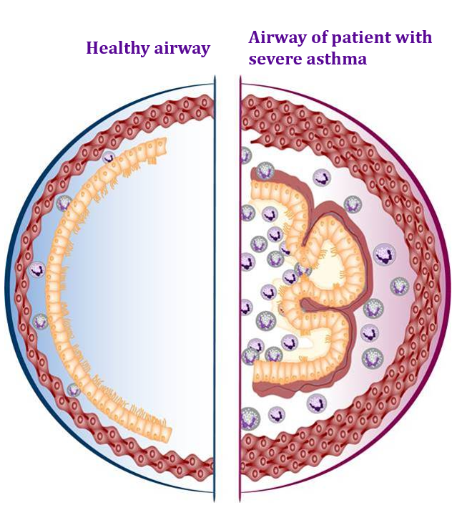
Healthy versus asthmatic airways Bacteriome composition
Healthy airways
Asthmatic airways
Balanced and diverse microbial community^{1–3}
Dominated by commensal bacteria⁴
Comparable diversity in healthy and mild asthma⁵
Reduced diversity and increased bacterial burden in severe asthma^{2,3,6}
Sputum more likely to be pathogen dominated in patients with severe asthma⁵
Clinically relevant bacterial species include:⁵
Haemophilus influenzae
Moraxella catarrhalis
Streptococcus pneumoniae
Low mucus burden
Intact epithelium
Excess mucus accumulation
Epithelial damage, barrier disruption
Inflammation

Slide 15
Healthy versus asthmatic airways Homeostasis versus dysbiosis
Healthy airways
Asthmatic airways
Commensal bacteria maintains compositional stability over time^{1,2}
Epithelial integrity supports the maintenance of homeostasis³
Bacteriophages contribute to microbial homeostasis through regulating bacterial populations⁴
Dysbiosis is associated with inflammation and exacerbations, and vice-versa⁵
Reduced colonisation resistance permits opportunistic pathobiont expansion (e.g., Streptococcus, Haemophilus and Moraxella) linked to worse control and exacerbations^{2,5,6}

Slide 16
Healthy versus asthmatic airways Epithelial function
Healthy airways
Asthmatic airways
Healthy epithelium
Epithelium of a patient with severe asthma
Tight and adherens junctions maintain epithelial barrier integrity¹
Goblet cells produce mucus, which traps inhaled microbes, and is mechanically moved out of the respiratory tract by cilia, along with any trapped microbes¹
Epithelial and immune cells secrete antimicrobial peptides that regulate microbial growth and maintain a balanced airway microbiota²
Barrier disruption allows microbes to cross the epithelium, which activates the immune system³
Goblet cell hypersecretion and impaired mucociliary clearance leads to changes in the microbiome composition^{3–5}
Epithelial barrier dysfunction and chronic inflammation can impair antimicrobial peptide production^{2,3,6}
TSLP/ IL-25/ IL-33
Mucus
TSLP
Microbiome

Slide 17
Healthy versus asthmatic airways Immune response
Healthy airways
Asthmatic airways
Microbiome-epithelium-immune system response cycle^{1–3}
Inner circle: healthy airways
Outer circle: airway of a patient with severe asthma
The airway microbiota is essential in supporting a healthy immune response¹
Bacteriome regulates innate and adaptive immune response initiated in the lungs and promotes epithelial repair¹
Pathogens increase triggering of chronic inflammation¹
T2 inflammatory pathways can be activated by lung dysbiosis, creating a cycle of dysbiosis and inflammation, similarly to other conditions associated with airway infection such as bronchiectasis^{1–3}
Microbiome imbalance
Balanced microbiome
Controlled immune system
Epithelial barrier maintained
Inflammation and epithelial barrier disruption
Immune activation

Slide 18
Healthy versus asthmatic airways Exacerbations
Healthy airways
Asthmatic airways
Healthy microbiome rebounds post-infection¹
Diverse stable microbiome protects against inflammation^{2,3}
Drivers of exacerbations^{4–8}
Increased abundance of bacteria, e.g., Moraxella or Streptococcus, in the nasal microbiota is associated with recurrent wheeze in young children and adolescents^{4,5}
The diversity and composition of the upper-airway microbiome are associated with asthma exacerbations despite ICS treatment⁶
While asthma exacerbations are heterogeneous, a proportion are associated with dysbiosis and pro-inflammatory cytokines, but antibiotics not routinely recommended^{9,10}
Viral infection/ environmental trigger
Host immune dysregulation
Microbiome disturbance
Exacerbation

Slide 19


Healthy versus asthmatic airways Nutrient availability
Healthy airways
Asthmatic airways
Microbes coexist via nutrient sharing and cross-feeding^{1,2}
Functional cooperation between host and microbiome maintains nutrient balance and prevents pathogen colonisation^{2,3}
Dysbiosis fosters competition, biofilm formation, and metabolic adaptation^{4–6}
Biofilm formation promotes infection persistence^{5,7–9}
Changes in nutrient concentrations in the airways, such as glucose, increase susceptibility to infection^{10,11}
Nutrients present in airways:
Glucose¹⁰
Amino acids and vitamins¹²
Lipids¹²
Trace metals, such as iron¹²
Nutrient cross-feeding between microbes¹
Nutrient competition between microbes¹

Slide 20

Healthy versus asthmatic airways Environmental and therapeutic effects
Healthy airways
Asthmatic airways
Exposure to natural environmental microbes supports airway microbial diversity and immune resilience^{1–3}
The microbiome has a balanced response to environmental exposures and can recover quickly from transient changes in the environment^{4–6}
Antibiotics cause a controlled microbial response, with the microbiome typically regaining equilibrium^{4,7,8}
Healthy epithelium^{4–6}
Epithelium of a patient with severe asthma^{9–14}
Environmental pollutants (e.g., black carbon) disrupt microbial composition and the epithelium, and increase inflammation^{9,10}
Interventions that affect airway microbes:
Antibiotics: Repeated exposure may disturb the diversity within the microbiome^{11,12}
Corticosteroids: Influence airway microbial communities due to their immunosuppressive effects and disruption of airway commensals^{12–14}
Microbiome
Recovery
Dysbiosis

Slide 21
Healthy versus asthmatic airways Summary of host-microbiome interactions in asthma
Healthy airway^{1–4}
Airway of a patient with severe asthma^{1–4}
Mucus overproduction
Intact epithelial barrier
Dysfunctional epithelial barrier
TSLP
TSLP/ IL-25/ IL-33
Upregulated epithelial cytokine release
Epithelial and microbiome crosstalk: Homeostasis relies on epithelial integrity and controlled microbial growth; barrier dysfunction fosters dysbiosis^{1,4–7}
Immune modulation: Commensal bacteria train innate and adaptive immunity; immune modulation and chronic (T2) inflammation drive goblet cell hypersecretion favouring pathogen enrichment^{4,8–10}
Nutrient and environmental inputs: Nutrient availability, pollutants and antibiotic exposure shape the microbiome and host responses^{8,11–14}

Slide 22
The influence of the microbiome on the pathophysiology of asthma
22

Slide 23
The microbiome influences disease severity
Relationships between the airway microbiome and markers of disease severity:¹
Inflammation:
Exacerbations:
Alterations to the airway microbiota drive or modulate inflammatory processes¹
High‑fat diet induced obesity–associated gut dysbiosis amplifies airway inflammation²
Enrichment of H. influenzae, Pseudomonas aeruginosa, and S. aureus in the lower airways of severe asthmatics are associated with asthma persistence and exacerbations³
Degree of airway obstruction:
Symptoms:
Airway obstruction is associated with lower alpha diversity and reduced abundance of commensal bacteria in BAL in patients with asthma³
Increased bacterial burden, especially Pseudomonadaceae and Enterobacteriaceae, is associated with severe asthmatics, and Actinomycetaceae is associated with eosinophilic asthma³
Exacerbations are associated with a sharp decline in airway microbiota diversity¹

Slide 24
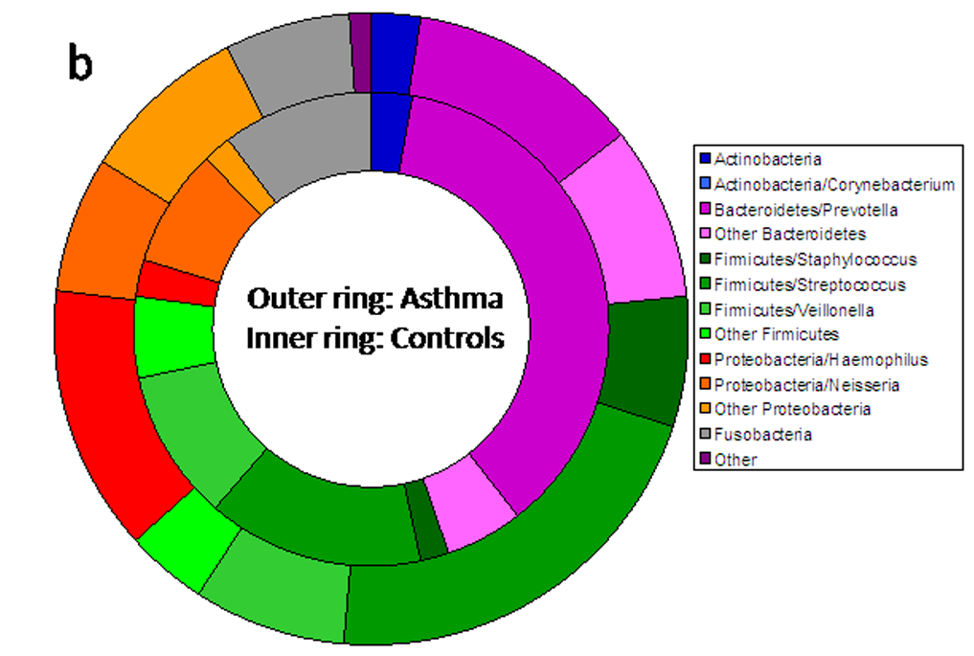
Microbiome composition differs between individuals with asthma and healthy controls^{1,2}
There are significant differences in the diversity of the airway microbiota between patients with asthma and healthy controls¹
E.g., a significantly higher proportion of the phylum Proteobacteria in patients with asthma compared with healthy controls
Different dominant species in the airway microbiome are associated with different patient characteristics, e.g., Haemophilus influenzae dominance is associated with²
Longer disease duration
Higher sputum neutrophils
Higher rates of exacerbations
Higher rates of OCS use
Lower sputum macrophages, with the presence of sputum eosinophilia only, in some subjects
Comparison of the airway microbiota of patients with asthma and healthy controls¹

Slide 25
The sputum microbiome may serve as a biomarker for characterising a more severe asthma phenotype
Microbiome profiling of sputum samples of patients with severe asthma identified two clusters of patients; broadly described as more or less severe asthma
 | Less severe asthma (Cluster 1; n=75) | More severe asthma (Cluster 2; n=25)
Microbiome characteristics | Similar to healthy individuals Higher microbial richness Higher α-diversity | Dysbiosis Lower microbial richness Lower α-diversity
Microbiome composition | Increased absolute abundance of bacteria, including Bacillota, Bacteriodota, Actinomycetota, and to a lesser extent Pseudomonadota | Increased relative abundance of certain species, such as Haemophilus influenzae, Moraxella catarrhalis, and Streptococcus pseudopneumoniae*
Clinical characteristics | Higher percentages of sputum macrophages and better lung function | Higher percentages of sputum and blood neutrophils
Environmental characteristics | More likely to live in urban areas | More likely to live in rural areas
Treatment | Corticosteroid use appeared comparable between clusters; however, interpretation is limited by the small sample size of Cluster 2 | More likely to have been prescribed long-acting anticholinergics; corticosteroid use appeared comparable between clusters; however, interpretation is limited by the small sample size of Cluster 2

Slide 26
Understanding of the airway microbiome is constantly evolving and further research is needed^{1–8}
Key areas of future airway microbiome research are:
Standardisation^{4,7}
Longitudinal studies^{4,7}
Standardised sampling, sequencing, and analysis protocols would improve understanding of the microbiome, support better mapping of the airway microbiome in health and disease, and support pooling of data and limitations related to small sample sizesª
Clinical translation^{4,7,8}
Longitudinal study designs would support characterisation of the dynamic airway microbiome over time or at a specific event, e.g., exacerbations
Clinical studies may identify robust biomarkers that can be translated for the development of microbial-based diagnostics and to guide precision therapies
Outstanding topics of interest:
Why does an individual develop dysbiosis?
Why does dysbiosis persist in certain individuals?
How should intervention be approached (e.g., proactively with probiotics to maintain health or reactively with antibiotics)?

Slide 27
Summary
Once thought sterile, the lung is now recognised to host a diverse microbiota^{1,2}
Asthma is associated with reduced microbial diversity and dominance of pathogens such as Haemophilus influenzae or Moraxella catarrhalis^{3,4}
Airway epithelial integrity and immune regulation maintain microbial homeostasis; barrier dysfunction fosters dysbiosis and chronic inflammation^{5,6}
Pollutants, antibiotics, and corticosteroids perturb microbial composition, while natural microbial exposures promote diversity and resilience^{7,8}
Airway microbiome profiles, such as the dominance of a specific bacterial species, may serve as biomarkers of severe asthma and guide future microbiome-targeted therapies^{1,4,9,10}
Future research into the airway microbiome composition, longitudinal studies to clarify causality, and translation toward microbiome-based diagnostics and interventions are needed^{11,12}

